Slide 1

SHIKUSI DISPENSARY Web application
Product design
MMUST/HEALTHIT/2023/01-A

Slide 2

PROBLEM
Provision of an electronic medical records management application for Shikusi Dispensary.

Slide 3

Sofware Design Process
PROTOTYPING METHOD APPLIED
Design and development process to involve creation of prototype that would be evaluated against the system requirements and improvements done to perfect the application.

Slide 4

PARTS of the application
Web frontend
Database
Web backend
REST API

Slide 5
FRONTEND COMPONENTS
REGISTRATION MODULE
QUEUEING MODULE
TRIAGE MODULE
Opd module
VISUALIZATION MODULE

Slide 6
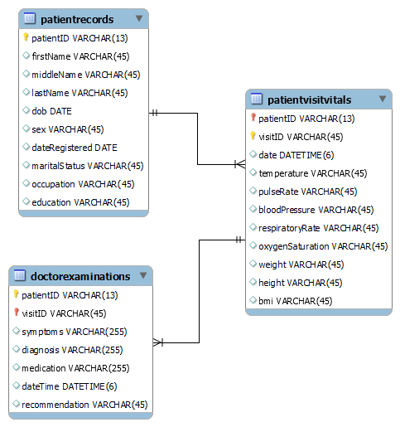
INITIAL DATABASE DESIGN

Slide 7
THANK YOU

